Slide 1


Second Term Quiz Revision
Grade 11 Units 7,8 &9
Time Allotted
40 minutes
Prepared by:Mrs.Madleen Nabil
2026

Slide 2

1
Vocabulary
2
Grammar
Total 80 Marks
3
Writing
40 Marks
20 Marks
20 Marks

Slide 3
Vocabulary

Slide 4
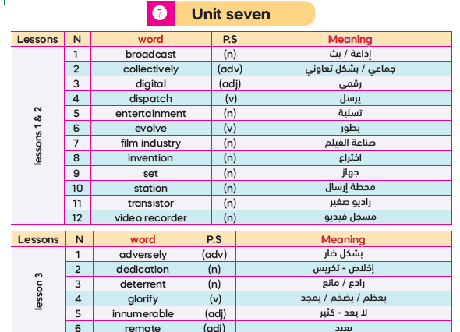
37

Slide 5
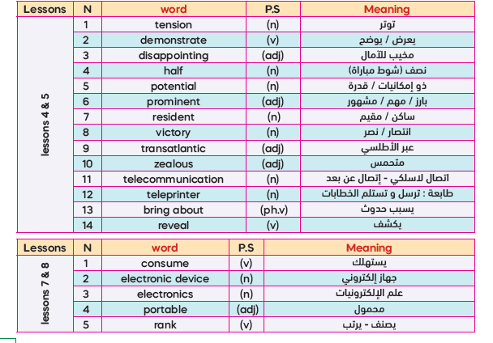

Slide 6
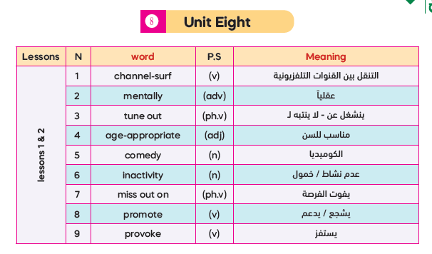
24

Slide 7
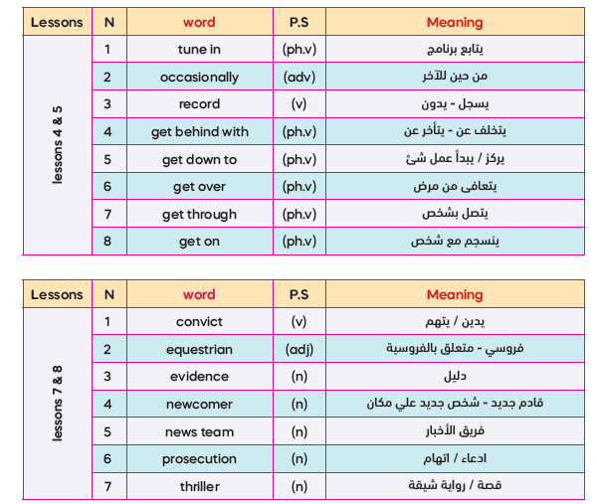

Slide 8
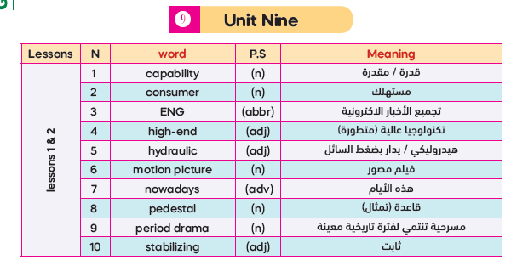
31

Slide 9
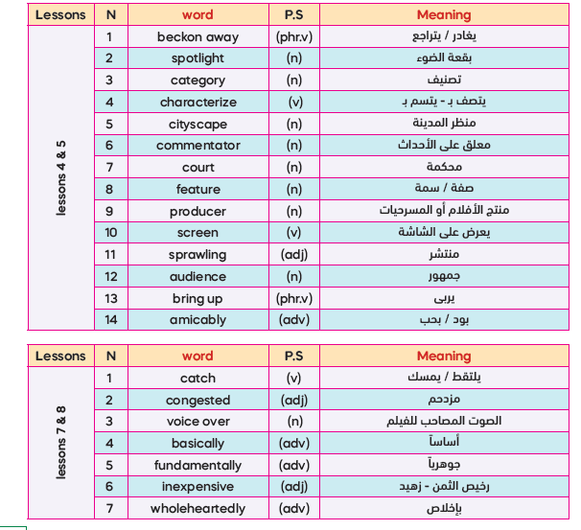

Slide 10


Slide 11
I- Vocabulary (20 Marks)
A -From a, b, c and d choose the most suitable word that best completes each of the
following sentences: (4x 5 = 20 Marks)
Tom………….his work because he was off school for a month.
got over b) got behind with c) got on d) got through
2. The children’s show was very…………..as it lacked excitement and enjoyment.
equestrian b) digital c) disappointing d) sprawling
3. Smoking and eating fast food may………..affect our health.
occasionally b) adversely c) wholeheartedly d) amicably
4. The skillful…….………managed to give a lively description of the final match.
entertainment b) pedestal c) thriller d) commentator

Slide 12
I- Vocabulary (20 Marks)
A -From a, b, c and d choose the most suitable word that best completes each of the
following sentences: (4 x 5 = 20 Marks)
If we work…………as a group, we can finish the project before the deadline.
occasionally b) adversely c) collectively d) menally
2. There is a live………….of football match on sports channel now.
category b) broadcast c) teleorinter d) capability
3. It took Ali weeks to……………the flu, but now he feels much better.
get down to b) get on c) get over d) get through
4. Mexico City is a…………..city of more than 20 million inhabitants
sprawling b) zealous c) hydraulic d) portable

Slide 13
I- Vocabulary (20 Marks)
A -From a, b, c and d choose the most suitable word that best completes each of the
following sentences: (4 x 5 = 20 Marks)
Tom was………..…by his grandparents after his parents had died.
Tuned in b) tuned out c) backoned away d) brought up
2. The school principal…………..supported our campaign to clean our school.
collectively b) adversely c) mentally d) wholeheartedly
3. The police released the suspect because there was no…………..to prove him guilty.
comedy b) evidence c) auidence d) inactivity
4. There is no attempt to provide any solution for the…………..….roads near the city centre.
digital b) hydraulic c) congested d) zealous

Slide 14
I- Vocabulary (20 Marks)
A -From a, b, c and d choose the most suitable word that best completes each of the
following sentences: (4 x 5 = 20 Marks)
Nowadays people use their cell phones to…………….beautiful moments of their life.
convict b) record c) characterise d) rank
2. Social media platforms play a………..……..role in our social life.
transatlantic b) portable c) prominent d) congested
3. …………………., my father allows me to go swimming with friends.
Fundamentally b) Mentally c) Collectively d) Occasionally
4. We climbed the mountain and enjoyed wonderful……………………. .
newcomer b) comedy c) cityscape d) dedication

Slide 15

Second Term Quiz

Slide 16
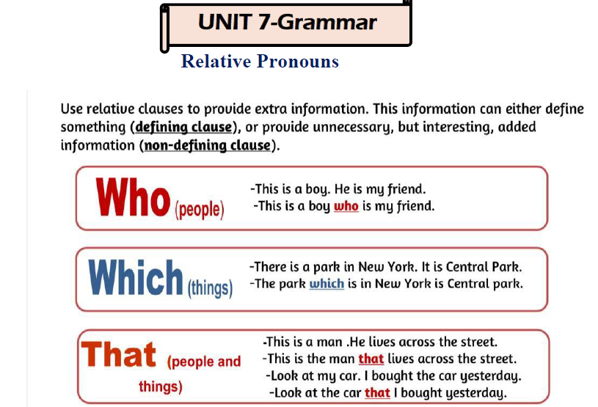

Slide 17
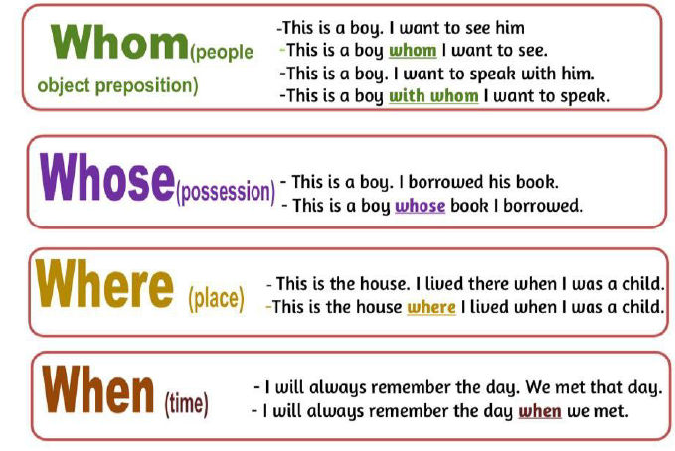

Slide 18
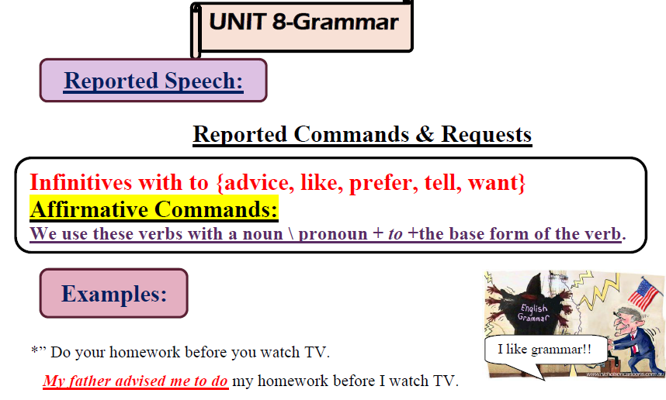

Slide 19
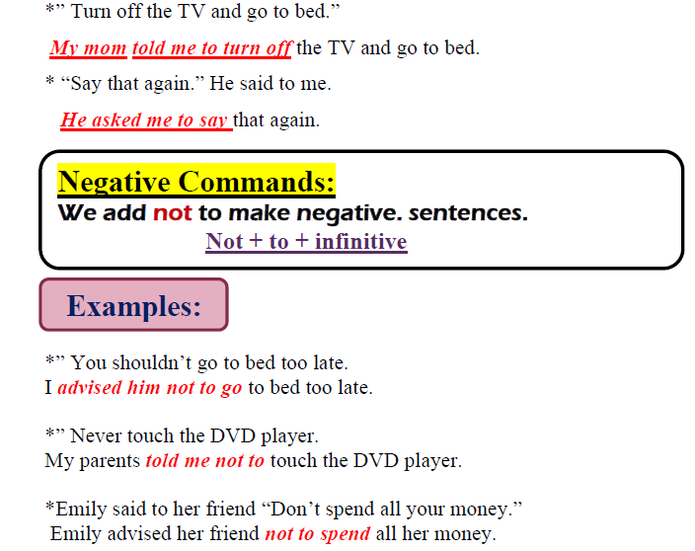

Slide 20
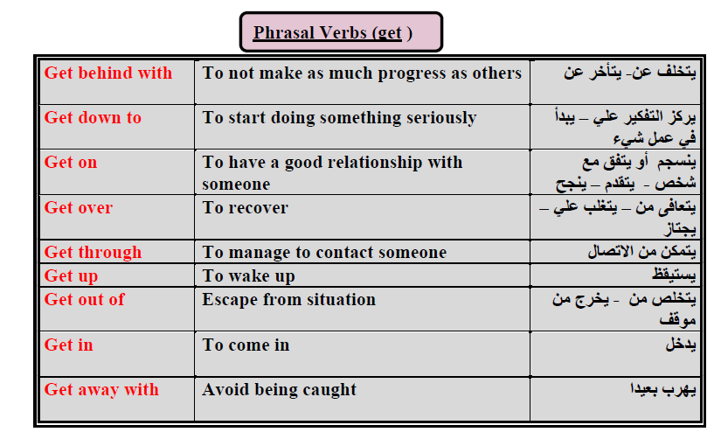

Slide 21
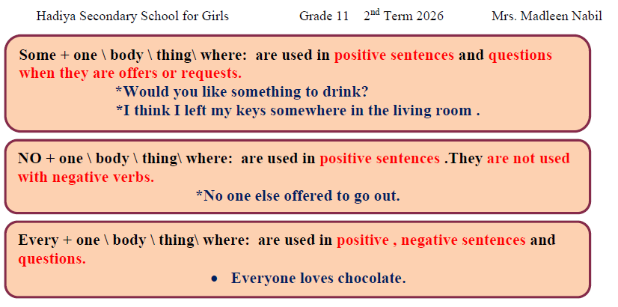
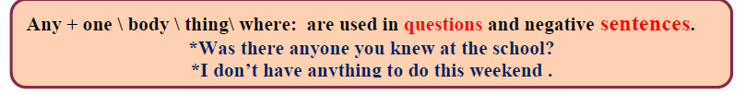

Slide 22
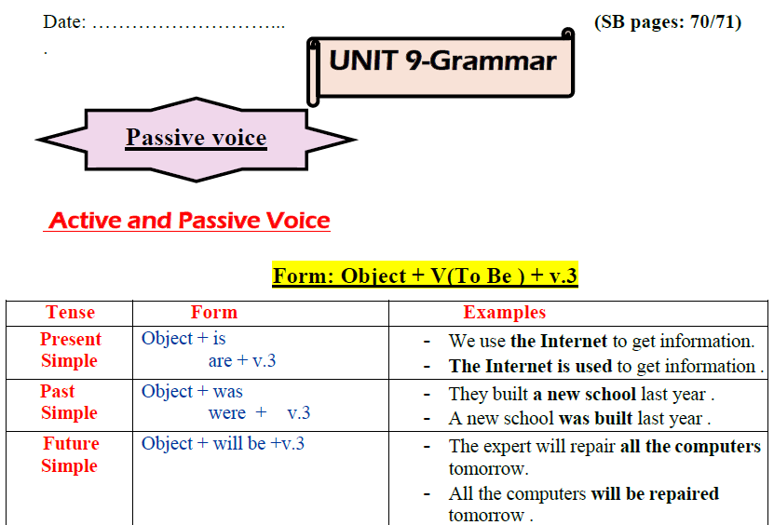

Slide 23
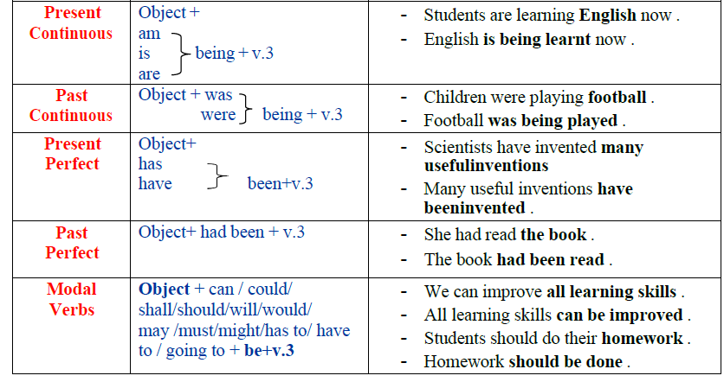

Slide 24
B- From a, b, and c, choose the correct answer as required:
Second Term Quiz

Slide 25



01- Scientists have invented many useful inventions. (Change into passive)
a. Many useful inventions are invented.
b. Many useful inventions have been invented.
c. Many useful inventions are being invented.
Subject
verb
b. Many useful inventions have been invented.
Tense
Present perfect
has/have
Passive
has/have been +v3

Slide 26
02- Students are writing the lesson at the moment. (Change into passive)
a. The lesson has been written at the moment.
b. The lesson is being written at the moment.
c. The lesson was written at the moment.
Subject
verb
Present continuous
present continuous
am/is/are + ving
(Passive) am/is/are being+v3
b. The lesson is being written at the moment.

Slide 27
03-We should encourage people to read more to improve their English. (Make passive)
People should encourage to read more to improve their English.
b. People are encouraged to read more to improve their English.
c. People should be encouraged to read more o improve their English.
can could should Auxiliary must will must has to have to | be | Past participle (Verb 3)
c. People should be encouraged to read more to improve their English.

Slide 28
04- “Would you bring me a cup of coffee, please?” (Change into reported speech)
a. Mona asked me to bring her a cup of coffee.
b. Mona asked me not to bring her a cup of coffee.
c. Mona asked me that you bring me a cup of coffee.
negative
sentence
would you bring to+ inf.
a. Mona asked me to bring her a cup of coffee.

Slide 29
05- My mother said to me “Don’t watch TV all day?” (Report the sentence)
My mother advised me to don’t watch TV all day.
b. My mother advised me not to watch TV all day.
c. My mother advised me didn’t watch TV all day.
don’t/ never
not to
b. My mother advised me not to watch TV all day.

Slide 30
06- “You should revise your lessons regularly.” (Change into reported speech)
a. My teacher advised me to revise my lessons regularly.
b. My teacher advised me you should revise my lessons regularly.
c. My teacher advised me to you should revise your lessons regularly.
Sentence
sentence
you should to+ inf.
a. My teacher advised me to revise my lessons regularly .

Slide 31
07- There is something wrong with my computer. (Make negative)
There isn’t something wrong with my computer.
b. There isn’t nothing wrong with my computer.
c. There is nothing wrong with my computer.
c. There is nothing wrong with my computer.

Slide 32
08. Everyone in our class passed the final test. (Make negative)
a. No one in our class passed the final test.
b. Someone in our class passed the final test.
c. Anyone in our class passed the final test.
Everyone No one
a. No one in our class passed the final test.

Slide 33
09- We can find something interesting to watch. (Make negative)
a. We can’t find nothing interesting to watch.
b. We can’t find anything interesting to watch.
c. We can’t find something interesting to watch.
Doesn’t come with not
negative
Doesn’t come with not
Something ( negative) not + any Or nothing (without not)
b. We can’t find anything interesting to watch.
anything

Slide 34
10- I bought a new laptop. The new laptop is very light. (Join using:which)
I bought a new laptop which is very light.
b. I bought a new laptop which it is very light.
c. I bought a new laptop which the laptop is very light.
thing
a new laptop (The laptop / repetition)
I bought a new laptop which is very light.

Slide 35
11-My brother works at a hospital. His son is a teacher. it. . (Join using: whose)
a. My brother, whose his son is a teacher, works at a hospital.
b. My brother works at hospital whose his son is a teacher.
c. My brother, whose son is a teacher, works at a hospital.
Possessive
…. his ..
c. My brother whose son is a teacher, works at a hospital.

Slide 36
12- The man is very friendly. He lives next door. (Join using: who)
The man who lives next door is very friendly.
b. The man is very friendly who he lives next door .
c. Who the man is very friendly he lives next door.
repetition
(Person) who (Verb)
The man who lives next door is very friendly.

Slide 37


Slide 38
B – From a, b, and c, choose the correct answer as required: (4 x 5 = 20 Marks)
1. Olivia had read the book when I reached there. (Change into passive)
The book had been read by Olivia when I reached there.
The book has been read by Olivia when I reached there.
The book has been reading by Olivia when I reached there.
2. I am afraid there is (someone) I can do to help you. (Correct)
I am afraid there is everything I can do to help you.
I am afraid there is nobody I can do to help you.
I am afraid there is nothing I can do to help you.

Slide 39
3 - That was the day. I decided to quit my job on that day.
(Join using :when)
That was the day when I decided to quit my job on that day.
That was the day , I decided to quit my job on when that day.
That was the day when I decided to quit my job.
4 – “ Never forget to call your parents.” (Change into reported speech)
a) My friend told me don’t forget to call your parents.
b) My friend told me not to forget to call your parents.
c) My friend told me never forget to call your parents.

Slide 40


3
Paragraph Writing

Slide 41

V- WRITING (40 Marks)
Write a paragraph on the following topic:
Some people think TV is a great source of information and entertainment, while others believe it has a negative influence on people.
Plan and write a six-sentence paragraph discussing the arguments for and against watching TV and stating your point of view.

Slide 42
(Outline – 5 Marks)
I- Introductory sentence: ……………………………………………………………………………………………………..
……………………………………………………………………………………………………..
Some people are for watching TV, while others are against.
II- Supporting details:
……………………………………………………………………………………………..……..
……………………………………………………………………………………………..……..
……………………………………………………………………………………………..……..
……………………………………………………………………………………………..……..
III- Concluding sentence:
……………………………………………………………………………………………..……..
…………………………………………………………………………………………..………..
Arguments for TV
*source of entertainment
*teaching a new language
Arguments against TV
*wasting time
*teaching violence
I think ,TV is a device with pros and cons, but the control is in our hands.

Slide 43
The topic (35 Marks)
……………………………………………………………………………………..…………………………………………………………………………………………………..…………………………………………………………………………………………………..…………………………………………………………………………………………………..…………………………………………………………………………………………………..…………………………………………………………………………………………………..…………………………………………………………………………………………………..…………………………………………………………………………………………………..…………………………………………………………………………………………………..…………………………………………………………………………………………………..…………………………………………………………………………………………………..…………………………………………………………………………………………………..…………………………………………………………………………………………………..…………………………………………………………………………………………………..…………………………………………………………………………………………………..……………
Some people are for watching TV, while others are against. One of its benefits is that it is a source of entertainment. It can also teach a new language. However, it can waste time if we watch it for long hours. Add to this, Some programs may promote violence that may affect children badly. I think, TV is a device with pros and cons, but the control is in our hands.

Slide 44
All the best
Mrs. Madleen Nabil

