Slide 1


Second Term Quiz Revision
Grade 10 Units 7,8 & 9
Prepared by:Mrs.Madleen Nabil
Time Allotted
40 minutes
2026

Slide 2

1
Vocabulary
2
Grammar
Total 60 Marks
3
Writing
30 Marks
20 Marks
10 Marks

Slide 3
Vocabulary

Slide 4
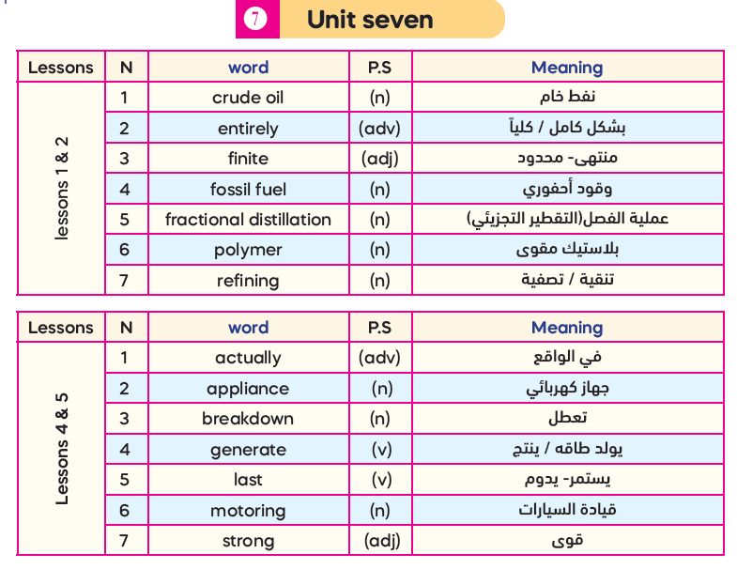
29

Slide 5
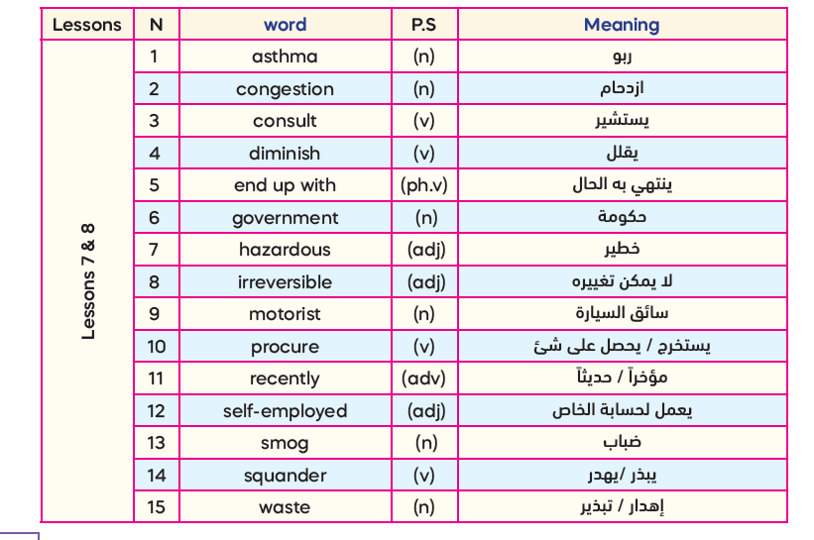

Slide 6
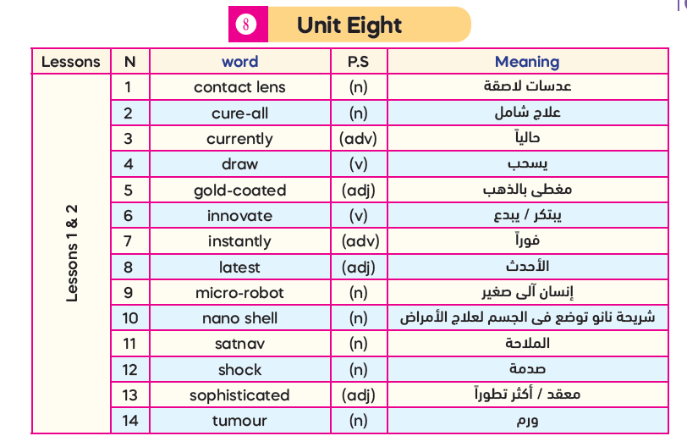
32

Slide 7
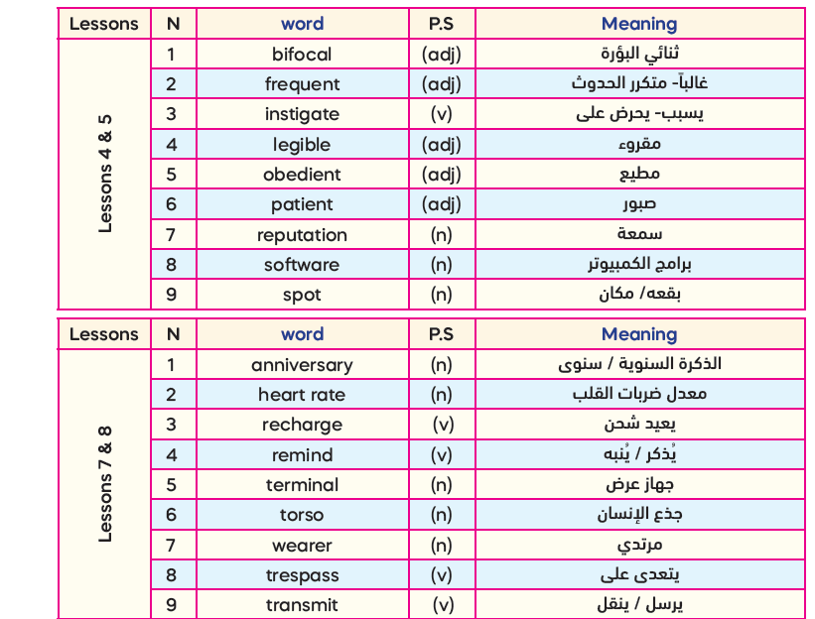

Slide 8
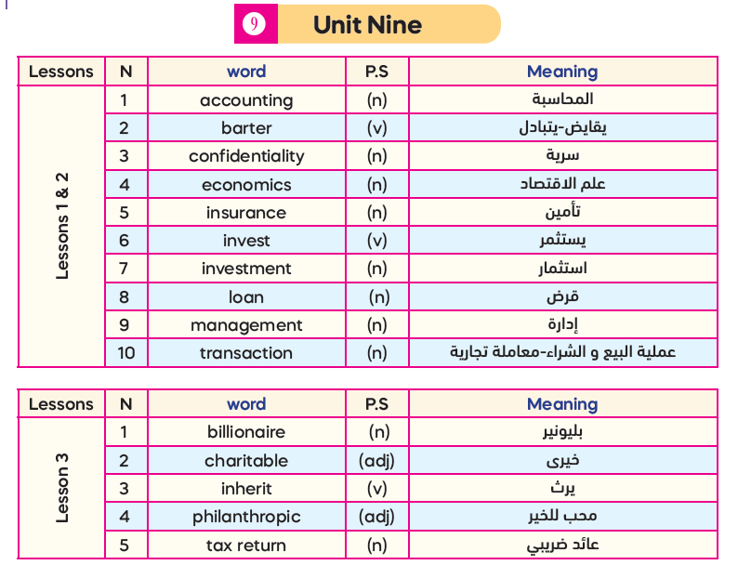
29

Slide 9
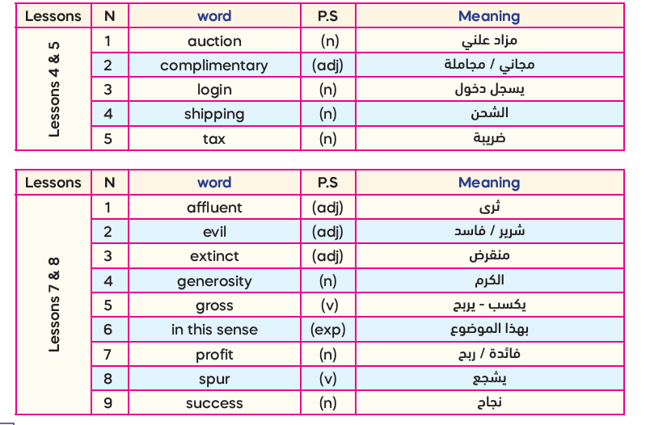

Slide 10


Slide 11
I- Vocabulary (20 Marks)
A -From a, b, c and d choose the most suitable word that best completes each of the
following sentences: (4x 5 = 20 Marks)
The………………..build new roads to improve transportation within cities.
software b) wearer c) motorist d) government
2. You should ………………….your mobile ,its battery is almost low and will die soon.
gross b) trespass c) recharge d) barter
3. Emily is…………….living in Kuwait but plans to move next year.
instantly b) recently c) currently d) actually
4. Some people believe that money is the root of all evil because it………….crime.
innovates b) spurs c) invests d) inherits

Slide 12
I- Vocabulary (20 Marks)
A -From a, b, c and d choose the most suitable word that best completes each of the
following sentences: (4 x 5 = 20 Marks)
It is better to………..the social worker if you have a serious problem at school.
consult b) invest c) diminish d) procure
2. The more…………….the device is , the more expensive it will be.
patient b) sophisticated c) complimentary d) affluent
3. Olivia responded to the message…………..…, without wasting any time.
instantly b) currently c) actually d) recently
4. A successful bank manager must study…………and management to enhance his skillset.
economic b) congestion c) login d) auction

Slide 13
I- Vocabulary (20 Marks)
A -From a, b, c and d choose the most suitable word that best completes each of the
following sentences: (4 x 5 = 20 Marks)
Although they are twins, their personalities are…………..different.
currently b) instantly c) recently d) entirely
2. Merit eagerly tracks the………….progress of her online order every day.
polymer b) success c) management d) shipping
3. Emily will write the report because her handwriting is more………..than mine.
legible b) charitable c) patient d) extinct
4. I like this photograph. It always………….me of the happy moments with my family.
invests b) reminds c) instigates d) transmits

Slide 14
I- Vocabulary (20 Marks)
A -From a, b, c and d choose the most suitable word that best completes each of the
following sentences: (4 x 5 = 20 Marks)
Most paid websites require a…………permission to give access to their contents.
login b) smog c) refining d) loan
2. Students shouldn’t……….their time watching TV instead of studying for exams.
barter b) generate c) consult d) squander
3. Olivia is…………and respectful , always following her mother’s instructions.
philanthropic b) frequent c) finite d) obedient
4. This restaurant has a good………….in serving the best sea-food in the country.
insurance b) spot c) reputation d) waste

Slide 15

2nd Term Quiz

Slide 16
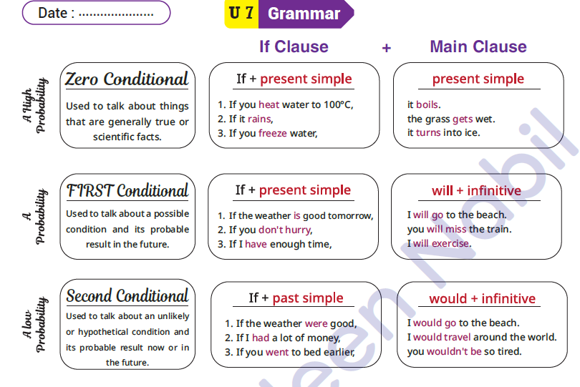

Slide 17
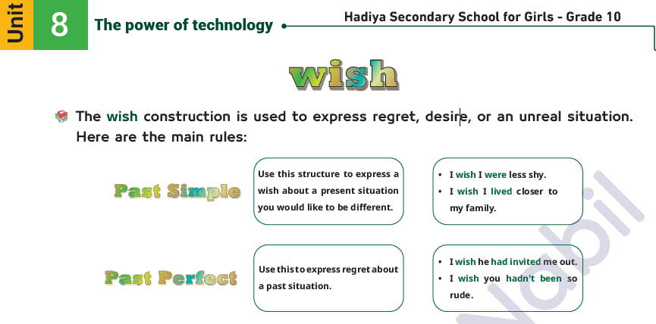

Slide 18
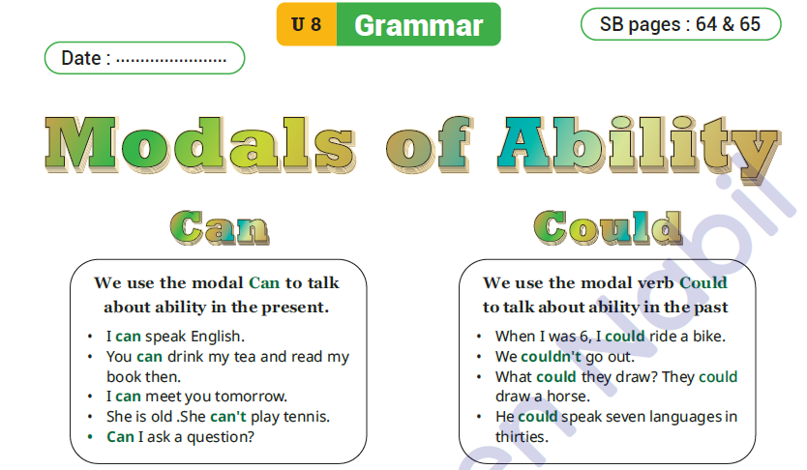

Slide 19
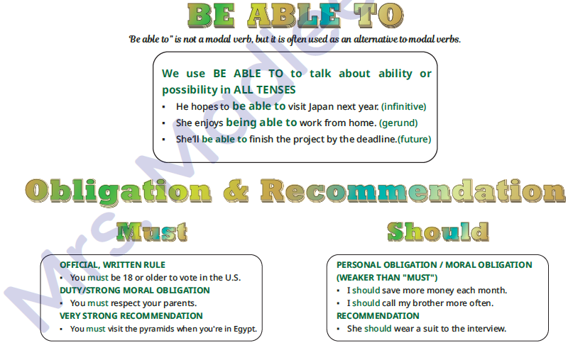

Slide 20
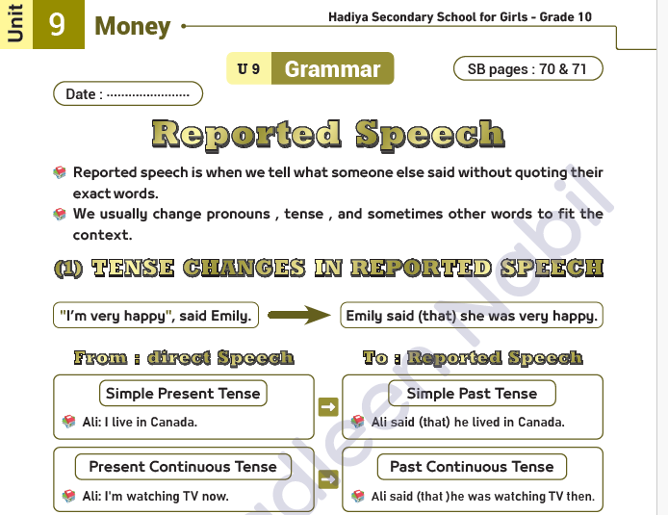

Slide 21
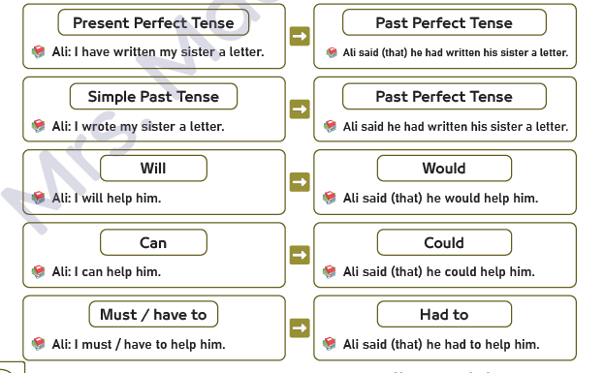

Slide 22
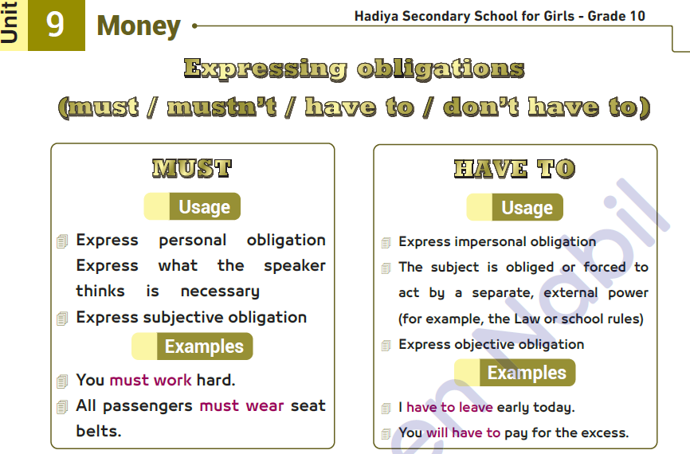

Slide 23
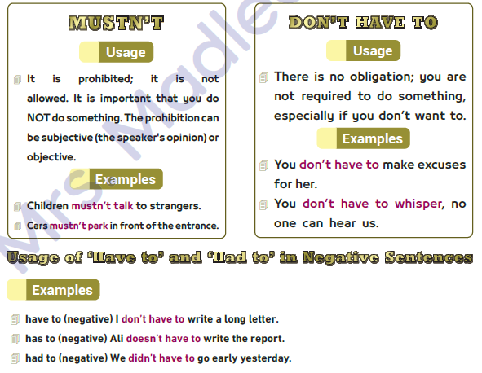

Slide 24
B- From a, b, and c, choose the correct answer as required:
2nd Term Quiz

Slide 25


01- She has to pay for water in restaurants. (Make negative)
She didn’t have to pay for water in restaurants.
b. She has not had to pay for water in restaurants.
c. She doesn’t have to pay for water in restaurants.
c. She doesn’t have to pay for water in restaurants.

Slide 26
02-If she (accept) the job offer, she will have to relocate to a new city. (Correct the verb)
a. If she accepted the job offer, she will have to relocate to a new city
b. If she accepts the job offer, she will have to relocate to a new city.
c. If she is accepting the job offer, she will have to relocate to a new city.
If+ present simple
Will + Inf
b. If she accepts the job offer, she will have to relocate to a new city.

Slide 27
03-If I had received my electronic passport earlier,…………………………… (Complete)
a. If I had received my electronic passport earlier, I will travel.
b. If I had received my electronic passport earlier, I would have travelled
c.If I had received my electronic passport earlier, I may travel.
Past perfect
would have+v3
Would have +v3
If
had + v3
Would have+v3
b. If I had received my electronic passport earlier, I would have travelled.

Slide 28
04. Merit doesn’t have much money, she wishes she (be) rich. (Correct)
a. Merit doesn’t have much money, she wishes she were rich.
b. Merit doesn’t have much money, she wishes she will be rich.
c. Merit doesn’t have much money, she wishes she has been rich.
Wish( present simple) Past Simple
a. Merit doesn’t have much money, she wishes she were rich.

Slide 29
05. “I have invited my friends to the party.” (Change into reported speech)
a. Emily said that she had invited her friends to the party.
b. Emily said that she has invited her friends to the party.
c. Emily said that she invites her friends to the party.
present perfect
Present Simple
Present Perfect (Past Perfect)
a. Emily said that she had invited her friends to the party.

Slide 30
06- Olivia had to come early to the party last week. (Make negative)
a. Olivia doesn’t have to come early to the party last week.
b. Olivia didn’t have to come early to the party last week.
c. Olivia hasn’t had to come early to the party last week.
had to (main verb)
present simple
Past Simple
Present Perfect
b. Olivia didn’t have to come early to the party last week.
didn’t have to

Slide 31
07-I don’t have a computer, I wish I………………………… (Complete)
a. I don’t have a computer, I wish I have a computer.
b. I don’t have a computer, I wish I had a computer.
c. I don’t have a computer, I wish I am having a computer.
Wish
Present Simple (Past Simple)
b. I don’t have a computer , I wish I had a computer.

Slide 32
08-If Adel (know) how to swim, he would go swimming. (Correct the verb)
a. If Adel knows how to swim, he would go swimming.
b. If Adel knew how to swim, he would go swimming.
c. If Adel is knowing how to swim, he would go swimming.
Past Simple
would +v1
Would +v1
If
Past simple(v2)
Would + Inf (v1)
b. If Adel knew how to swim, he would go swimming

Slide 33
09. “I visited my uncle last Friday.” (Change into reported speech )
a.Merit told me that she will visit her uncle last Friday.
b. Merit told me that she had visited her uncle the previous Friday.
c. Merit told me that she has visited her uncle the previous Friday.
Past Simple
( Reported Speech) Past Simple
Past Perfect (had+ v3)
b. Merit told me that she had visited her uncle the previous Friday .

Slide 34
10. My sister could come early to the party last week. (Make negative)
a. My sister couldn’t come early to the party last week.
b. My sister doesn’t come early to the party last week.
c. My sister won’t come early to the party last week.
present simple
Future Tense
could + not +V1
Add (not) to the helping verb
a. My sister couldn’t come early to the party last week .

Slide 35


Slide 36
B – From a, b, and c, choose the correct answer as required: (2 x 5 = 10 Marks)
1. If our father (not help) us , we wouldn’t solve the problem. ( Correct the verb)
If our father didn’t help us , we wouldn’t solve the problem.
If our father doesn’t help us , we wouldn’t solve the problem.
If our father hasn’t helped us , we wouldn’t solve the problem.
2. Emily could play music when she was three years old. (Ask a question)
What can Emily do when she was three years old?
What did Emily do when she was three years old?
What could Emily do when she was three years old?

Slide 37
B – From a, b, and c, choose the correct answer as required: (2 x 5 = 10 Marks)
1. It was a difficult question, I wish I (practise) more before the exam. ( Correct the verb)
It was a difficult question, I wish I had practiced more before the exam.
It was a difficult question, I wish I am practicing more before the exam.
It was a difficult question, I wish I have practiced more before the exam.
2. The teacher said to us, “ You must study your lessons today.” (Report the sentence)
The teacher told us that we must study our lessons that day.
The teacher told us that we had to study our lessons that day.
The teacher told us that we have to study our lessons that day.

Slide 38


3
Paragraph Writing

Slide 39

V- WRITING (40 Marks)
Write a paragraph on the following topic:
Without oil, life would be a different place.
Plan and write a six-sentence paragraph persuading your friend to conserve energy as it is finite.
Persuasive

Slide 40
(Outline – 5 Marks)
I- Introductory sentence: ……………………………………………………………………………………………………..
……………………………………………………………………………………………………..
Energy is finite, so we must conserve it.
II- Supporting details:
……………………………………………………………………………………………..……..
……………………………………………………………………………………………..……..
……………………………………………………………………………………………..……..
……………………………………………………………………………………………..……..
III- Concluding sentence:
……………………………………………………………………………………………..……..
…………………………………………………………………………………………..………..
*turning off unused lights
*sharing cars
*using public transport
*using stairs instead of lifts
In short, every small step we take to save energy makes a big difference.

Slide 41
The topic (25 Marks)
……………………………………………………………………………………..…………………………………………………………………………………………………..…………………………………………………………………………………………………..…………………………………………………………………………………………………..…………………………………………………………………………………………………..…………………………………………………………………………………………………..…………………………………………………………………………………………………..…………………………………………………………………………………………………..…………………………………………………………………………………………………..…………………………………………………………………………………………………..…………………………………………………………………………………………………..…………………………………………………………………………………………………..…………………………………………………………………………………………………..…………………………………………………………………………………………………..…………………………………………………………………………………………………..……………
Energy is finite, so we should conserve it. We can turn off unused lights to save electricity. We can also share cars to reduce energy use. Using public transport is another good way to save energy. We can use stairs instead of lifts to avoid wasting electricity. Every small step we take makes a big difference.

Slide 42
All the best
Mrs. Madleen Nabil

