Slide 1


SecondTerm Quiz Revision
Grade 12 Units 7,8&9
Prepared by:Mrs.Madleen Nabil
Time Allotted
40 minutes
2026

Slide 2

1
Vocabulary
2
Grammar
Total 80 Marks
3
Writing
40 Marks
20 Marks
20 Marks

Slide 3
Vocabulary

Slide 4
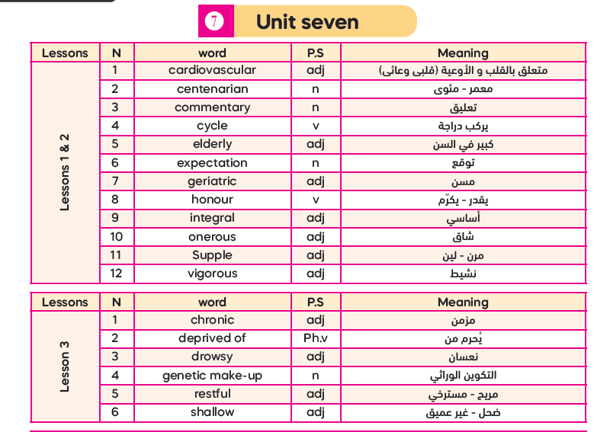
39

Slide 5
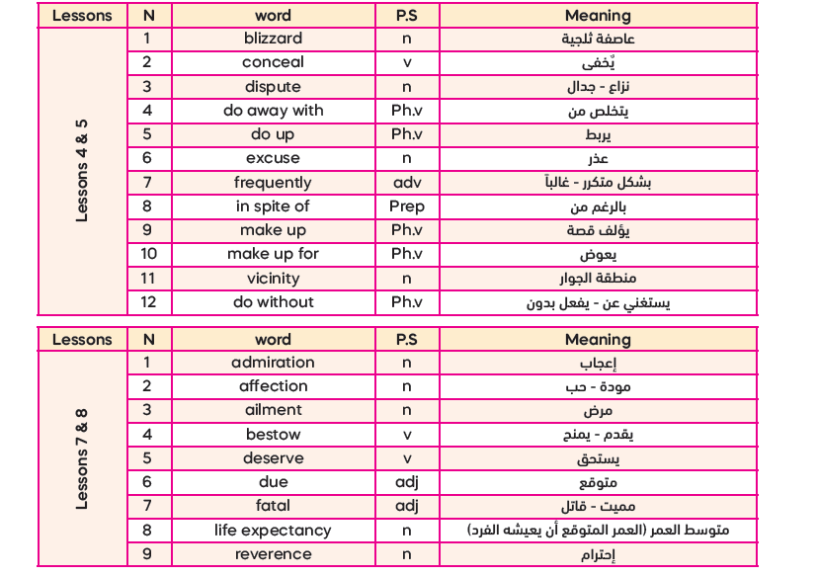

Slide 6
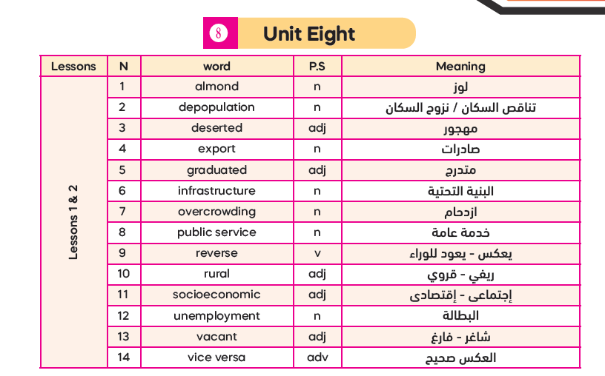
34

Slide 7
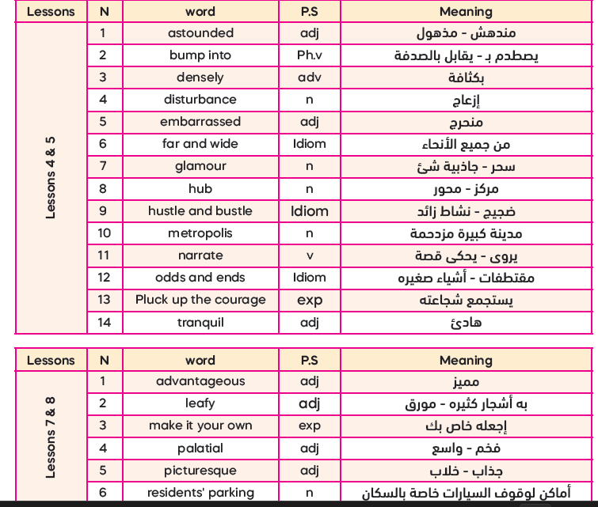

Slide 8
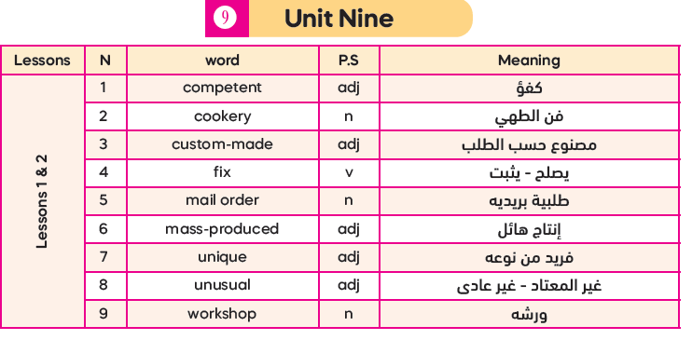
30

Slide 9
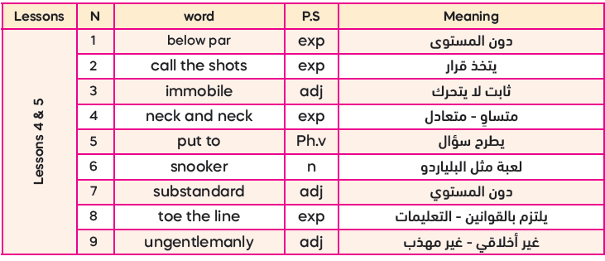
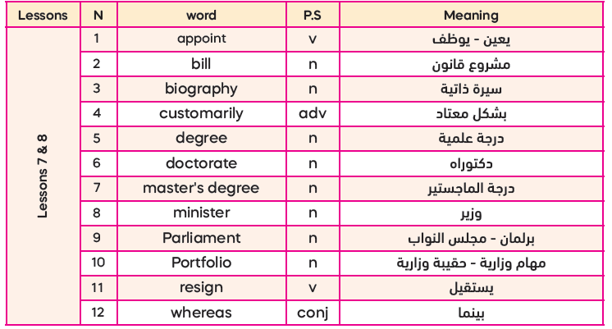

Slide 10


Slide 11
I- Vocabulary (20 Marks)
A -From a, b, c and d choose the most suitable word that best completes each of the
following sentences: (4x 5 = 20 Marks)
Each citizen is a/an……….part in the process of developing our country.
leafy b) vacant c) integral d) unusual
2. Problem of poverty and………….have increased this year in some countries.
portfolio b) almond c) minister d) unemployment
3. Lazy students always…………………..excuses for not doing their homework.
make up b) do without c) do away with d) make up for
4. I discovered so many amazing facts about my favourite writer in his………………… .
ailment b) biography c)blizzard d) parliament

Slide 12
I- Vocabulary (20 Marks)
A -From a, b, c and d choose the most suitable word that best completes each of the
following sentences: (4 x 5 = 20 Marks)
The little child was admired by all the audience for his ability to………..…exciting stories.
resign b) narrate c) reverse d) control
2. The new……………..has promised to lower the prices and improve the economy.
centenarian b) portfolio c) hub d) minister
3. Personal computers have helped us to………..….. a lot of paperwork.
make up b) do up c) do away with d) make up for
4.She moved from a small town to the………..…….,to pursue her dreams.
metropolis b) commentary c) doctorate d)parliament

Slide 13
I- Vocabulary (20 Marks)
A -From a, b, c and d choose the most suitable word that best completes each of the
following sentences: (4 x 5 = 20 Marks)
Both parents and teachers should be…………..…..because they have offered us a lot.
cycled b) narrated c) fixed d) hounoured
2. People living in…………….areas enjoy the beautiful sceneries and relaxing atmosphere.
elderly b) embarrassed c) rural d) substandard
3. Merit threatened to…………….from the company if her salary wasn’t paid.
appoint b) resign c) reverse d) conceal
4. Dubai is the business…………..…….of the Middle East.
affection b) excuse c) bill d) hub

Slide 14
I- Vocabulary (20 Marks)
A -From a, b, c and d choose the most suitable word that best completes each of the
following sentences: (4 x 5 = 20 Marks)
The teacher asked students to be quiet, as the constant talking was a/an………………
reverence b) almond c) disturbance d) hub
2. Doctors recommend a balanced diet to maintain good ........................health.
competent b) astounded c) tranquil d) cardiovascular
3. My uncle was………… ambassador to Kuwait after finishing his master’s degree.
reversed b) appointed c) concealed d) resigned
4. The accident was.......................,resulting in the loss of two lives.
fatal b) ungentlemanly c) tranquil d) supple

Slide 15


Second Term Quiz

Slide 16
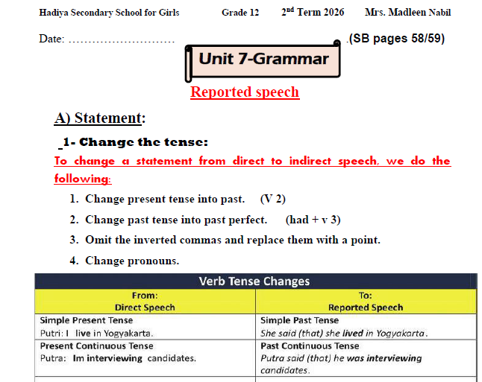

Slide 17
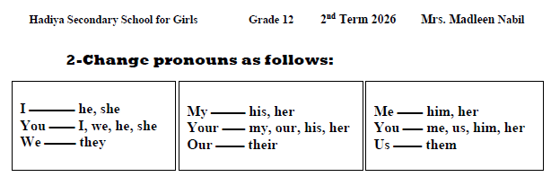

Slide 18
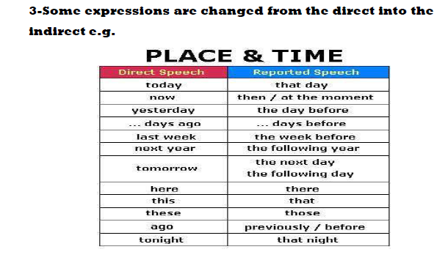

Slide 19
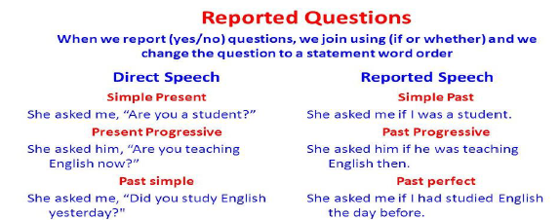
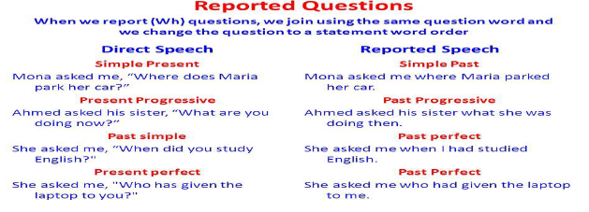

Slide 20
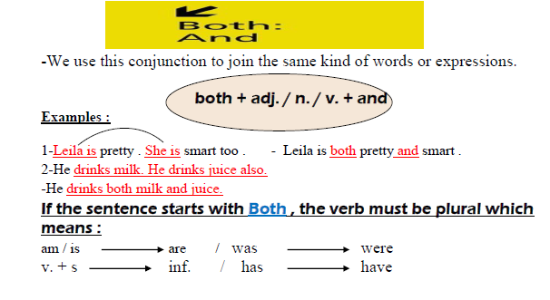

Slide 21
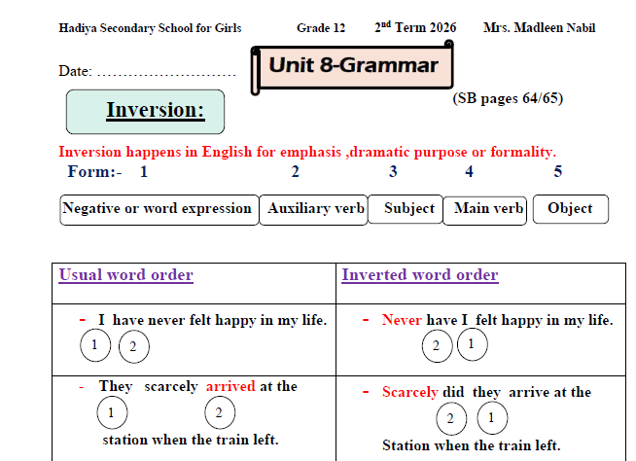

Slide 22
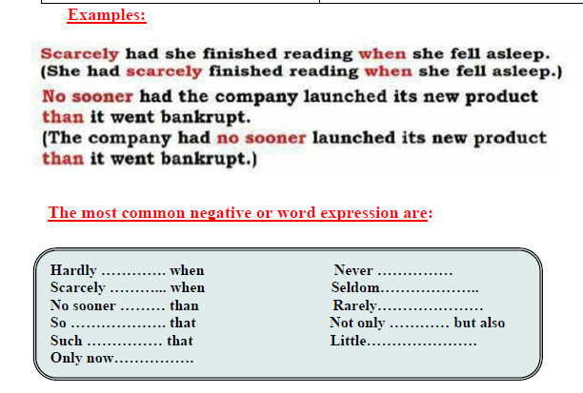

Slide 23
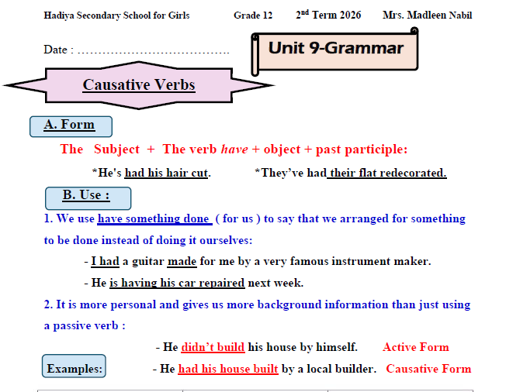

Slide 24
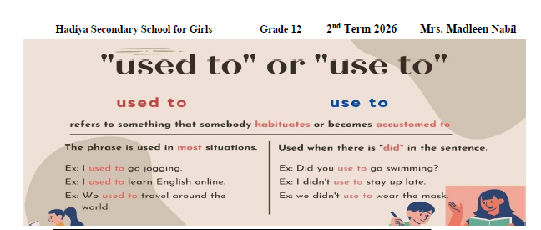

Slide 25

B- From a, b, and c, choose the correct answer as required:
Second Term Quiz

Slide 26


01-Emily is good at playing chess. Olivia is good at playing chess. (Use: both …… and)
a. Both Emily and Olivia are good at playing chess.
b. Both Emily and Olivia is good at playing chess.
c. Both Emily and Olivia was good at playing chess.
is
was
… both … and + plural …
Singular
a. Both Emily and Olivia are good at playing chess.

Slide 27
02- Samir likes reading newspapers. Omar likes reading newspapers ,too. (Use: both …… and)
a. Both Samir and Omar like reading newspapers.
b. Both Samir and Omar likes reading newspapers.
c.Samir both and Omar likes reading newspapers, too.
likes
likes
… both … and + plural …
Singular
a. Both Samir and Omar like reading newspapers.

Slide 28
03-“Where did you go at the weekend?” My friend said to me. (Change into reported speech)
My friend asked me where did I go at the weekend.
b. My friend asked me where I had gone at the weekend.
c. My friend asked me where had I gone at the weekend.
where
subject + verb
b. My friend asked me where I had gone at the weekend.

Slide 29
04- “I like to chew gum when I am at the cinema.” (Change into reported speech)
David told us that he liked to chew gum when he is at the cinema.
b. David told us that he likes to chew gum when he was at the cinema.
c. David told us that he liked to chew gum when he was at the cinema.
v1 is Present are Simple will has have must can | Change into | Past Simple (Verb 2)
c. David told us that he liked to chew gum when he was at the cinema.

Slide 30
05- “Have you ever been to Canada?” Emily said to me. (Change into reported speech)
a. Emily asked me if you had ever been to Canada.
b. Emily asked me if I had ever been to Canada.
c. Emily asked me that had I ever been to Canada.
Helping verbs(is /are/ has/have
1-Use : whether/ if
2-subject + verb
b. Emily asked me if I had ever been to Canada .

Slide 31
06-I have never seen such a beautiful scenery. (Begin with Never)
a. Never I have seen such a beautiful scenery.
b. Never have I seen such a beautiful scenery.
c. Never have seen I such a beautiful scenery.
Never
+ auxiliary verb
+ subject
b. Never have I seen such a beautiful scenery.

Slide 32
07 –I knew little that I was speaking to the great scientists Prof. David. (Begin with: Little)
Little have I known that I was speaking to the great scientist Prof. Dvid.
b. Little do I know that I was speaking to the great scientist Prof. Dvid.
c. Little did I know that I was speaking to the great scientist Prof. Dvid.
Main verb (past simple
c. Little did I know that I was speaking to the great scientist Prof. David.
Present Simple | do- does+ (V1) | Past Simple | Did + (v1)

Slide 33
08-We had scarcely finished the meeting when our boss called us. (Begin with: Scarcely)
Scarcely have we finished the meeting when our boss called us.
b. Scarcely had we finished the meeting when our boss called us.
c. Scarcely we had finished the meeting when our boss called us.
Scarcely + had
… when …
b. Scarcely had we finished the meeting when our boss called us.

Slide 34
09. I had no sooner reached the cinema than I realised that I had forgotten my ticket.
( Begin with No sooner)
No sooner have I reached the cinema than I realised that I had forgotten my ticket.
b. No sooner I had reached the cinema than I realised that I had forgotten my ticket.
c. No sooner had I reached the cinema than I realised that I had forgotten my ticket.
No sooner + had
…. than ..
c. No sooner had I reached the cinema than I realised that I had forgotten my ticket.

Slide 35
habit in the past
10- I used to play football when I was young. (Make negative)
I don’t use to play football when I was young.
b. I didn’t use to play football when I was young.
c. I won’t use to play football when I was young.
…didn’t use to ...
+ infinitive
b. I didn’t use to play football when I was young.

Slide 36
11-Mary used to make dress patterns when she was young. (Ask a question)
a. What did Mary use to make when she was young?
b. What does Mary use to make when she was young?
c. What has Mary used to make when she was young?
did use to + inf.
a. What did Mary use to make when she was young?

Slide 37
12-The technician is fixing my broken laptop. (Use causative)
My broken laptop is being fixed.
b. I will have my broken laptop fixed.
c. I am having my broken laptop fixed.
Present continuous
c. I am having my broken laptop fixed.
Subject | V. To Have have-has had -having | Object | Past participle of the main verb (V3)

Slide 38
13- I had all my documents (review)before submitting my application. (Correct the verb)
a. I had my documents are reviewing before submitting my application.
b. I had my documents reviewed before submitting my application.
c. I had my documents reviewing before submitting my application
Had +v3
Present continuous
V3
V+ing
b. I had all my documents reviewed before submitting my application.
reviewed

Slide 39


Slide 40
B – From a, b, and c, choose the correct answer as required: (4 x 5 = 20 Marks)
1. “We visited the museum yesterday." (Change into reported speech)
My friends told me that they were visiting the museum yesterday.
My friends told me that we have visited the museum the day before.
My friends told me that they had visited the museum the day before.
2. I had my car (repair) last week . (Correct the verb)
I had my car been repairing last week.
I had my car been repaired last week.
It had my car repaired last week.

Slide 41
3 - The party had scarcely started when the lights went out. (Begin with scarcely)
Scarcely does the party start when the lights went out.
Scarcely had the party started when the lights went out.
Scarcely has the party started when the lights went out.
4 – Tom is a smart student. Jeana is a smart student, too. (Join using: Both - and)
a) Both Tom and Jeana are smart student.
b) Both Tom and Jeana is a smart students.
c) Both Tom and Jeana are smart students, too.

Slide 42


3
Paragraph Writing

Slide 43

V- WRITING (40 Marks)
Write a paragraph on the following topic:
There are different arguments for and against living in the city.
Plan and write a six-sentence paragraph discussing the arguments for and against living in the city and stating your point of view.

Slide 44
(Outline – 5 Marks)
I- Introductory sentence: ……………………………………………………………………………………………………..
……………………………………………………………………………………………………..
Some people prefer living in the city, while others don’t.
II- Supporting details:
……………………………………………………………………………………………..……..
……………………………………………………………………………………………..……..
……………………………………………………………………………………………..……..
……………………………………………………………………………………………..……..
III- Concluding sentence:
……………………………………………………………………………………………..……..
…………………………………………………………………………………………..………..
Arguments for life in city
*well-paid jobs
*better public services
Arguments against city
* much pollution
*expensive life
In my opinion, living in the city is better despite its disadvantages.

Slide 45
The topic (35 Marks)
……………………………………………………………………………………..…………………………………………………………………………………………………..…………………………………………………………………………………………………..…………………………………………………………………………………………………..…………………………………………………………………………………………………..…………………………………………………………………………………………………..…………………………………………………………………………………………………..…………………………………………………………………………………………………..…………………………………………………………………………………………………..…………………………………………………………………………………………………..…………………………………………………………………………………………………..…………………………………………………………………………………………………..…………………………………………………………………………………………………..…………………………………………………………………………………………………..…………………………………………………………………………………………………..……………
Some people prefer living in the city, while others do not.
Living in the city has many advantages. Many people find good job opportunities that help them improve their lives .In addition, cities offer better services such as hospitals, schools, and transport. However, living in the city also has disadvantages. There is a lot of pollution.Moreover, life in the city is expensive for many people. In my opinion, living in the city is better despite its disadvantages.

Slide 46
All the best
Mrs. Madleen Nabil

