Slide 1


الوحدة السادسة
(6 – 3 )
الأسبوع
طـــول القوس
الحصة
التاريخ

Slide 2
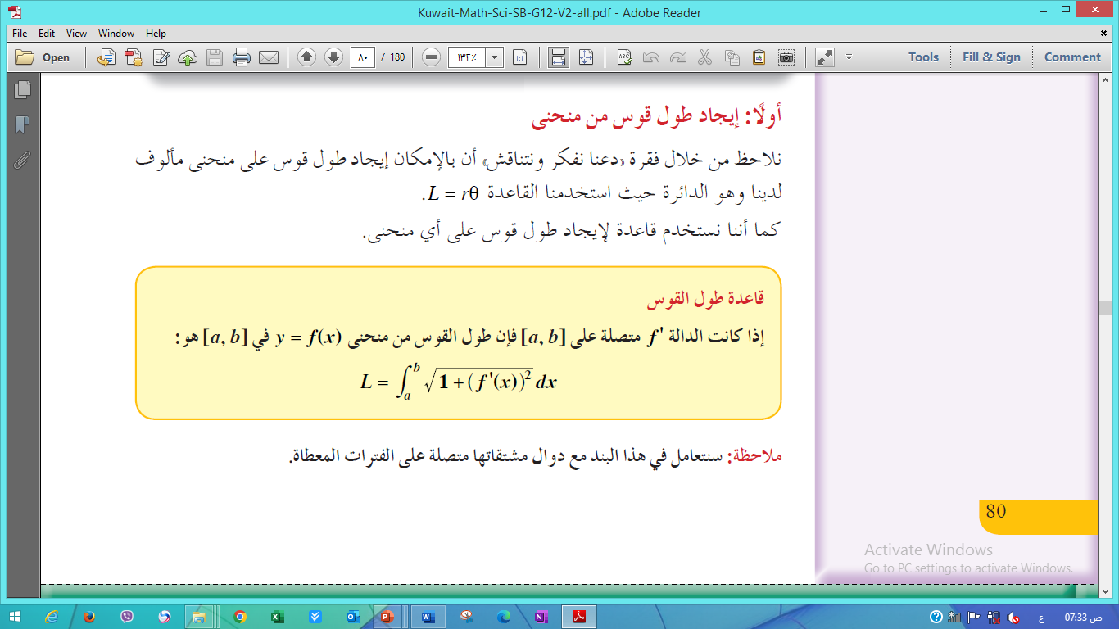
مثال 3
(6-3) طول قوس من منحنى دالة ص 82

Slide 3
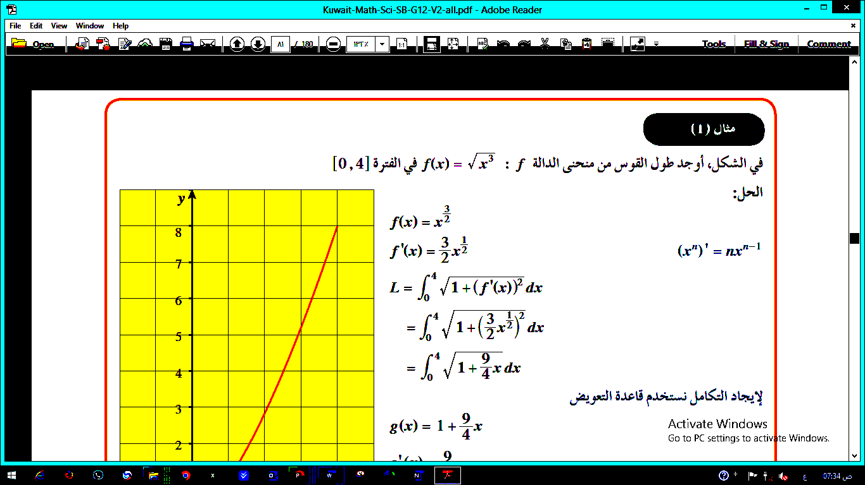
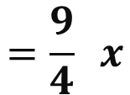
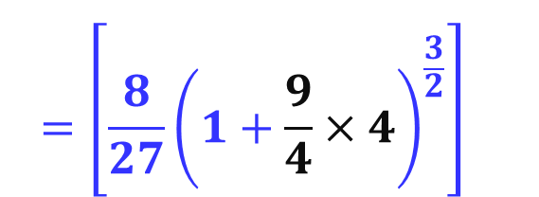
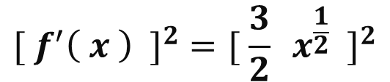
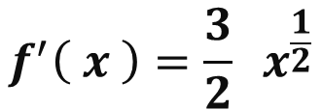
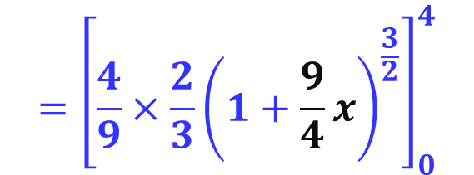


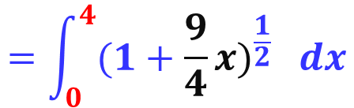
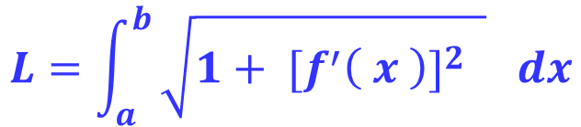
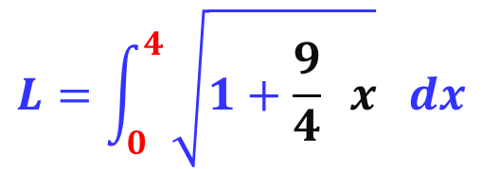
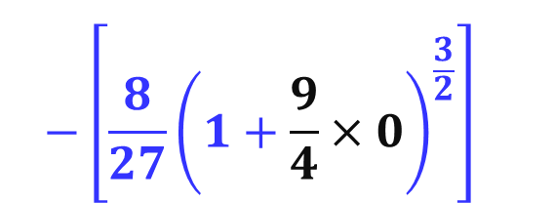
مثال 3
(6-3) طول قوس من منحنى دالة ص 82
$$L=\int_{a}^{b}{\sqrt{1+ {[f^{′}\left( x \right)]}^{2} } dx}$$
$$f\left( x \right)=x^{\frac{3}{2}}$$
$$f^{′}\left( x \right)=\frac{3}{2} x^{\frac{1}{2}}$$
$${{[ f}^{′}\left( x \right) ]}^{2}={[ \frac{3}{2} x^{\frac{1}{2}} ]}^{2}$$
$$=\frac{9}{4} x$$
$$L=\int_{0}^{4}{\sqrt{1+\frac{9}{4} x} dx}$$
$$=\int_{0}^{4}{{(1+\frac{9}{4}x)}^{\frac{1}{2}} dx}$$
$$={\left[\frac{4}{9}×\frac{2}{3}{\left(1+\frac{9}{4}x\right)}^{\frac{3}{2}}\right]}_{0}^{4}$$
تكامل بمجرد النظر
$$={\left[\frac{8}{27}{\left(1+\frac{9}{4}×4\right)}^{\frac{3}{2}}\right]}_{}^{}$$
$$−{\left[\frac{8}{27}{\left(1+\frac{9}{4}×0\right)}^{\frac{3}{2}}\right]}_{}^{}$$
$$=9.07unit$$

Slide 4
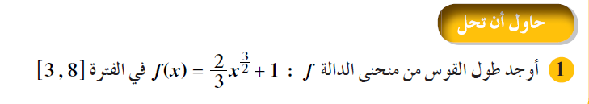
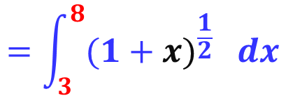

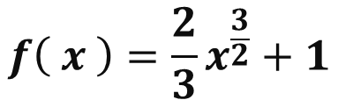
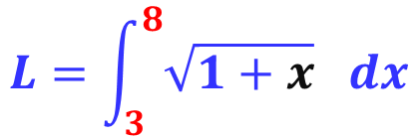
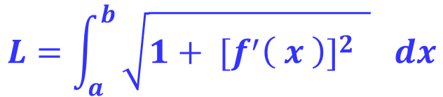




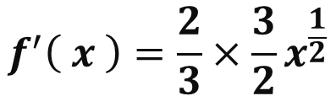
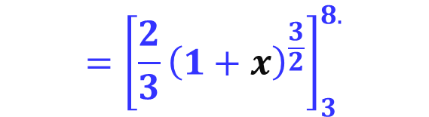

مثال 3
(6-3) طول قوس من منحنى دالة ص 82
$$L=\int_{a}^{b}{\sqrt{1+ {[f^{′}\left( x \right)]}^{2} } dx}$$
$$f\left( x \right)={\frac{2}{3}x}^{\frac{3}{2}}+1$$
$$f^{′}\left( x \right)=\frac{2}{3}×\frac{3}{2}x^{\frac{1}{2}}$$
$$=x^{\frac{1}{2}}$$
$${{[ f}^{′}\left( x \right) ]}^{2}={[x^{\frac{1}{2}} ]}^{2}$$
$$= x$$
$$L=\int_{3}^{8}{\sqrt{1+x} dx}$$
$$=\int_{3}^{8}{{(1+x)}^{\frac{1}{2}} dx}$$
$$={\left[\frac{2}{3}{\left(1+x\right)}^{\frac{3}{2}}\right]}_{3}^{8.}$$
تكامل بمجرد النظر
$$={\left[{\left(1+8\right)}^{\frac{3}{2}}\right]}_{}^{}$$
$$−{\left[{\left(1+3\right)}^{\frac{3}{2}}\right]}_{}^{}$$
$$=\frac{38}{3}unit$$

Slide 5
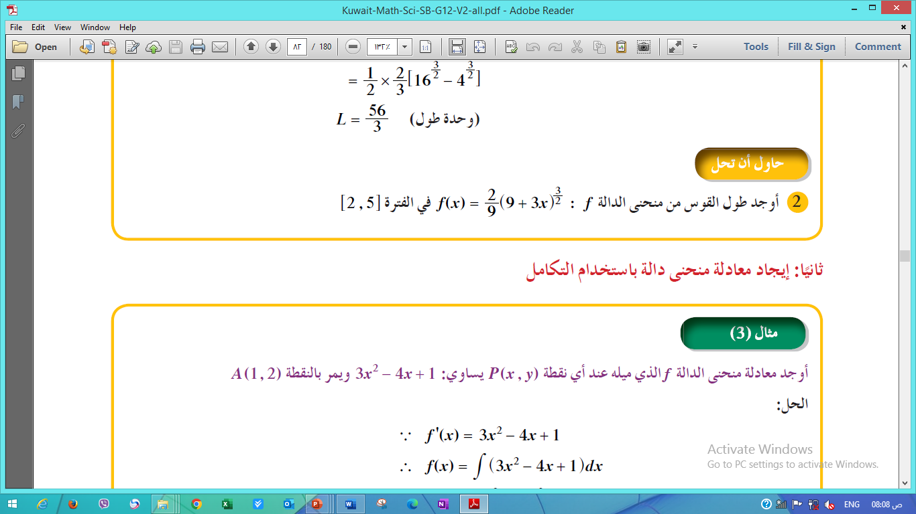
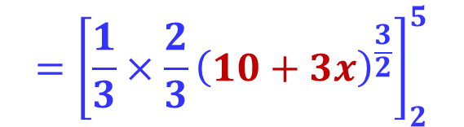
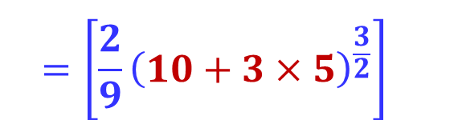
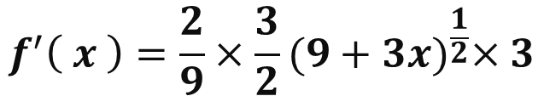
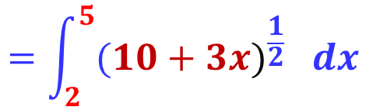

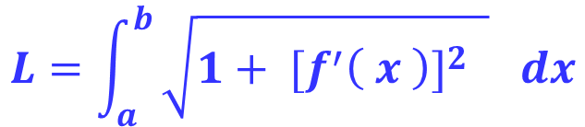
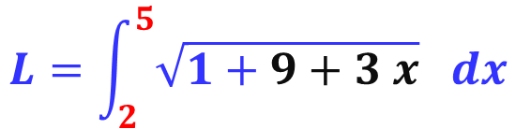


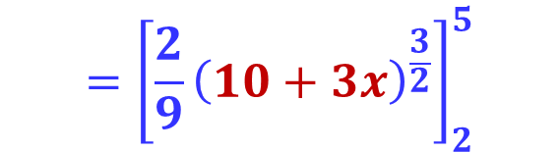

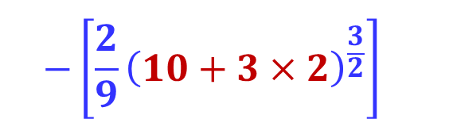
(6-3) طول قوس من منحنى دالة ص 82
مثال 3
$$L=\int_{a}^{b}{\sqrt{1+ {[f^{′}\left( x \right)]}^{2} } dx}$$
$$f^{′}\left( x \right)=\frac{2}{9}{×\frac{3}{2}(9+3x)}^{\frac{1}{2}}×3$$
$$f^{′}\left( x \right)={ (9+3x)}^{\frac{1}{2}}$$
$${{[ f}^{′}\left( x \right) ]}^{2}={[{ (9+3x)}^{\frac{1}{2}}]}^{2}$$
$$=9+3 x$$
$$L=\int_{2}^{5}{\sqrt{1+9+3 x} dx}$$
$$=\int_{2}^{5}{{(10+3x)}^{\frac{1}{2}} dx}$$
تكامل بمجرد النظر
$$={\left[\frac{1}{3}×\frac{2}{3}{\left(10+3x\right)}^{\frac{3}{2}}\right]}_{2}^{5}$$
$$={\left[\frac{2}{9}{\left(10+3x\right)}^{\frac{3}{2}}\right]}_{2}^{5}$$
$$={\left[\frac{2}{9}{\left(10+3×5\right)}^{\frac{3}{2}}\right]}_{}^{}$$
$${−\left[\frac{2}{9}{\left(10+3×2\right)}^{\frac{3}{2}}\right]}_{}^{}$$
$$=\frac{122}{9}unit$$

Slide 6


